Slide 1
City of Laredo
2018 Water/Wastewater Rate Study and Financial Forecast
City Council Presentation
April 2019

Slide 2
Facts about Water and WW Rates in the 21st Century
Average utility has been increasing rates 5-6% per year; trend expected to continue
AWWA expects water and wastewater rates across USA to triple in the next 15 years
Rate adjustments are primarily due to reasons beyond a utility’s control – inflation, system replacement, regulatory mandates, etc.
30-40% of utilities currently charge rates that do not cover their costs

Slide 3
City of Laredo Initial Observations
City’s policy of annual nominal rate adjustments has been beneficial – resulted in a financially healthy utility until current year
However, increasing costs and need to finance $150 -- $180 million in new debt for capital improvements will require future rate adjustments that will be higher than 2.0%
Costs and rate plan presented today are from 2018 study
Recommendations are being updated to account for revisions in budget, CIP and debt
Final recommendations unlikely to be materially different from 2018 estimates

Slide 4
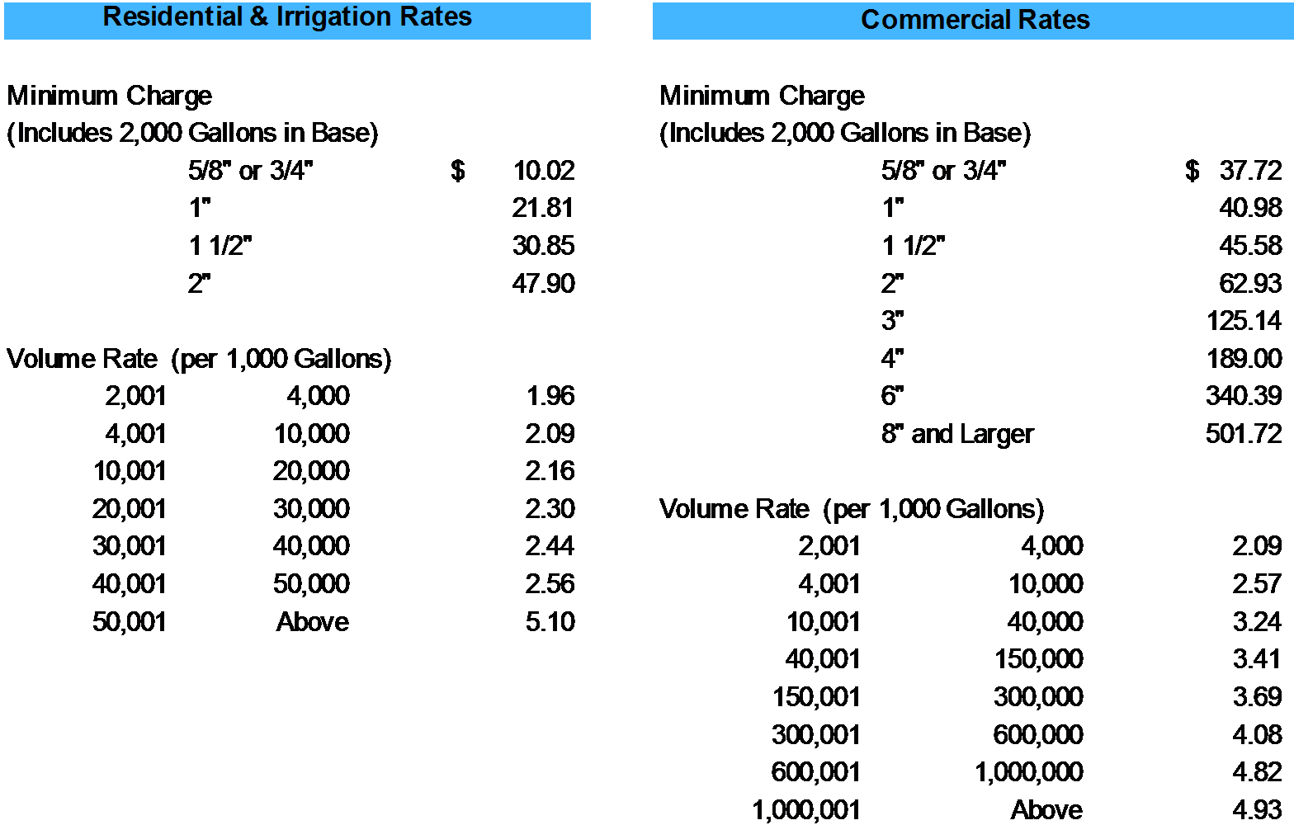
City of Laredo Current Water Rate Structure
NOTE: Effective October 2018

Slide 5
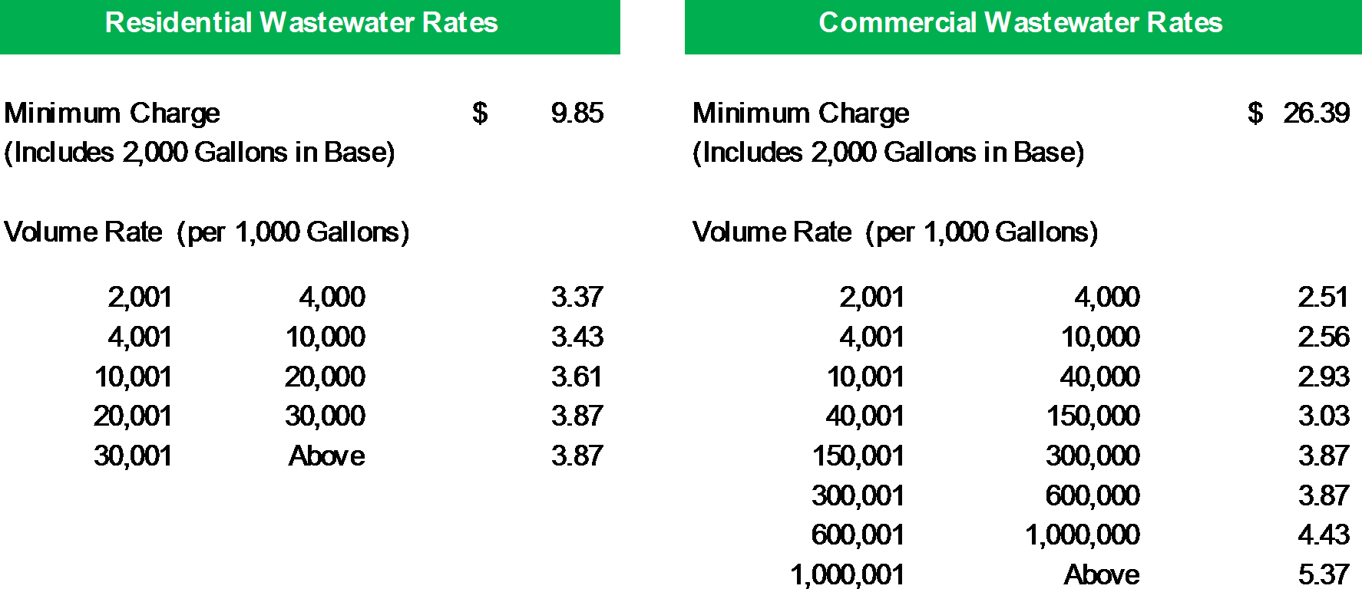
City of Laredo
Current Wastewater Rate Structure
NOTE: Effective October 2018

Slide 6
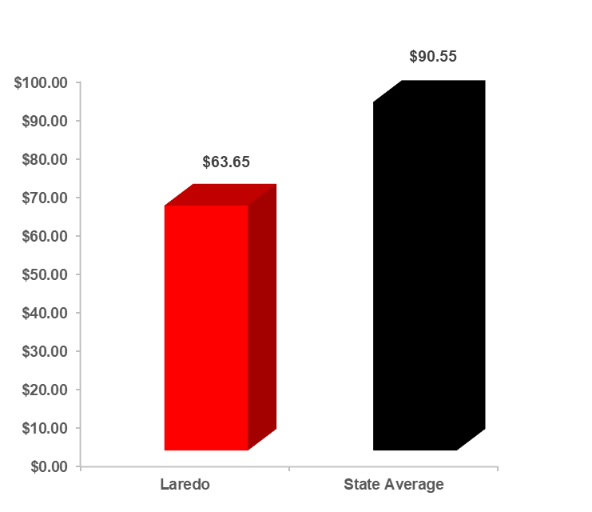
Monthly Residential Charge Comparison 10,000 Gal Water/Wastewater

Slide 7
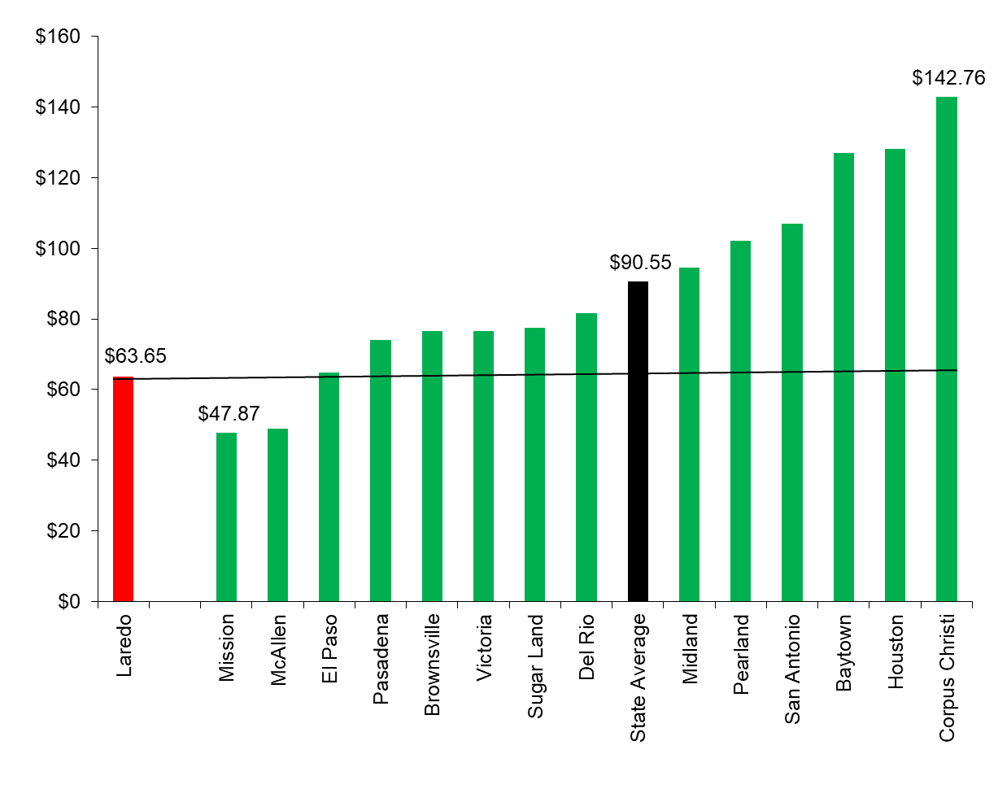
Monthly Residential Charge Comparison 10,000 Gal Water/Wastewater
Oct 2018

Slide 8
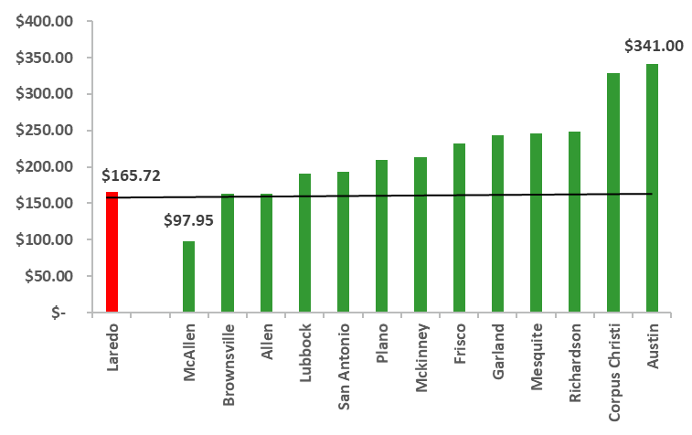
Monthly Commercial Charge Comparison 20,000 Gal Water/Wastewater

Slide 9
Actual and Forecast Total Water Accounts
100,000
2% Annual Growth
90,000
86,039
80,000
79,487
68,769
71,994
70,000
60,000
50,000
40,000
30,000
20,000
10,000
-
FY 2015 FY 2016 FY 2017 TY 2018
TY = Test Year
FY 2019 FY 2020 FY 2021 FY 2022 FY 2023
FY 2024 FY 2025 FY 2026 FY 2027

Slide 10
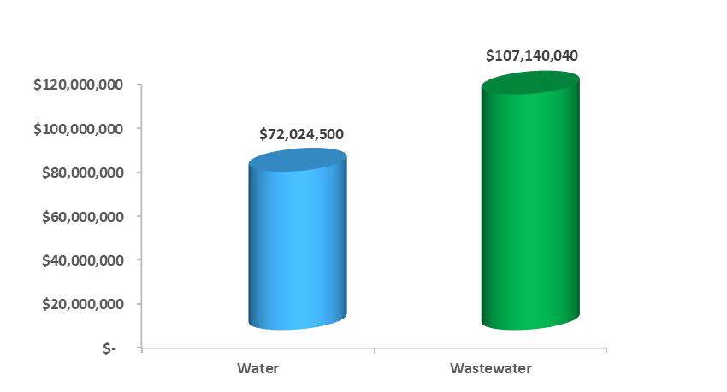
2018 Rate Study Capital Improvement Plan
Total -- $179,164,540

Slide 11
FORECASTED water
CAPITAL IMPROVEMENT PlAN FY 2019-2023
WATER
Lyon Tank Improvements | $8,020,000
Line Rehabilitation & Contingency Water Breaks | $8,800,000
8 MG Cuatro Vientos Booster Station | $6,600,000
Waterline Replacement | $5,700,000
24” Waterline – Hachar Loop | $6,895,000
Boring under Loop 20 project | $3,500,000
24” Waterline west side of Loop 20 | $2,750,000
Other Water CIP Projects | $29,759,500
11

Slide 12
FORECASTED wastewater
CAPITAL IMPROVEMENT PlAN FY 2019-2023
WASTEWATER
Manadas Creek WWTP 4.75 MGD | $52,000,000
Sewer Rehabilitation & Contingency Sewer Breaks | $8,000,000
Zacate to Chacon Creek Gravity Sewer Line(Additional funding) | $7,500,000
8” – 12” IH 69 Force Main Extension | $3,800,630
Eastern Chacon Interceptor | $7,000,000
In-House Projects | $5,210,000
North Laredo WWTP 3 MGD Expansion (Design only) | $2,500,000
Other Wastewater CIP Projects | $21,129,410
12

Slide 13
2018 Rate Study Forecast W/WW Bond Issues
Water Wastewater Total
2018 | $ - $ - $ -
2019 | - - -
2020 | - 41,000,000 41,000,000
2021 | 25,000,000 | 43,000,000 | 68,000,000
2022 | 13,000,000 | 10,000,000 | 23,000,000
2023 | 12,000,000 | 9,000,000 | 21,000,000
2024 | 22,000,000 | 4,000,000 | 26,000,000
2025 | - - -
2026 | - - -
2027 | - - -
Term = 25 Years Interest = 3.5% P&I = Fixed
$179,000,000 -- Total
Note: Debt Service for 2018 issue included as Current Debt not Future Debt

Slide 14
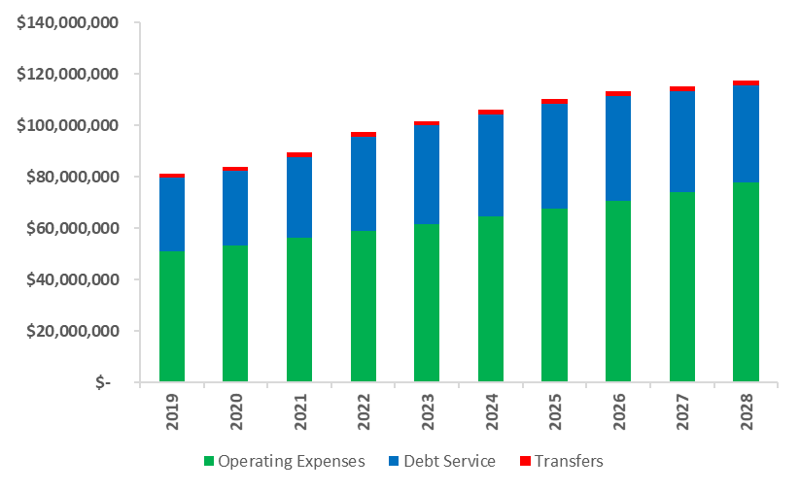
2018 Rate Study
Forecast Water/Wastewater Cost of Service

Slide 15
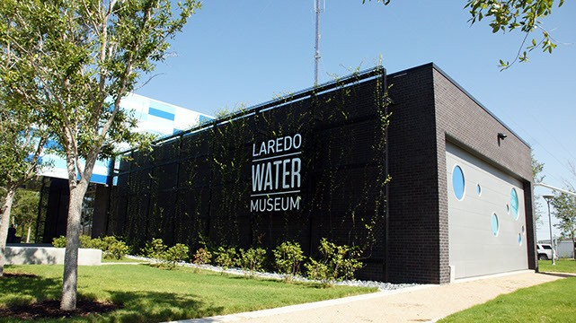
Notes on Rate Proposal
City’s policy of 2.0% annual rate adjustments have been effective in prior years in funding water and WW costs
However, combination of increasing operating costs and need to fund capital projects will require a nominal adjustment in City’s rate plan beginning October 2019
Combination of robust expected growth and higher adjustments to commercial W/WW rate is forecast to minimize impact on residential customers

Slide 16
2018 Rate Study Residential Water Rate Plan
EFFECTIVE DATE
Prior | Oct-18 | Oct-19 |  | Oct-20 |  | Oct-21 | Oct-22
 | Current Approved | Current Approved | Proposed | Current Approved | Proposed | Proposed | Proposed
$ 9.82 | $ 10.02 | $ 10.22 | $ 10.52 | $ 10.42 | $ 11.05 | $ 11.60 | $ 12.18
21.38 | 21.81 | 22.25 | 22.90 | 22.70 | 24.04 | 25.24 | 26.51
30.24 | 30.24 | 31.46 | 32.39 | 32.09 | 34.01 | 35.71 | 37.50
46.96 | 46.96 | 48.86 | 50.30 | 49.84 | 52.81 | 55.45 | 58.22
1.92 | 1.96 | 2.00 | 2.05 | 2.04 | 2.16 | 2.26 | 2.38
2.05 | 2.09 | 2.13 | 2.20 | 2.17 | 2.31 | 2.42 | 2.54
2.12 | 2.16 | 2.20 | 2.27 | 2.24 | 2.39 | 2.51 | 2.63
2.25 | 2.30 | 2.35 | 2.41 | 2.40 | 2.53 | 2.66 | 2.79
2.40 | 2.45 | 2.50 | 2.57 | 2.55 | 2.70 | 2.83 | 2.97
2.51 | 2.56 | 2.61 | 2.69 | 2.66 | 2.82 | 2.96 | 3.11
5.00 | 5.10 | 5.20 | 5.35 | 5.30 | 5.62 | 5.90 | 6.20
Residential & Irrigation
Base Charge (Includes 2,000 Gallons)
5/8" or 3/4"
1"
1 1/2"
2"
Volume Rates Per 1,000 Gallons
2,001 | 4,000
4,001 | 10,000
10,001 | 20,000
20,001 | 30,000
30,001 | 40,000
40,001 | 50,000
50,001 | Above
Annual 3.0% rate adjustments beginning October 2023

Slide 17
2018 Rate Study Commercial Water Rate Plan
 | EFFECTIVE DATE
 | Prior | Oct-18 | Oct-19 |  | Oct-20 |  | Oct-21 | Oct-22
 |  | Current Approved | Current Approved | Proposed | Current Approved | Proposed | Proposed | Proposed
Commercial
Base Charge (Includes 2,000 Gallons)
5/8" or 3/4" | $ 36.99 | $ 37.73 | $ 38.48 | $ 39.61 | $ 39.25 | $ 41.59 | $ 43.67 | $ 45.85
1" | 40.18 | 40.98 | 41.80 | 43.03 | 42.64 | 45.18 | 47.44 | 49.81
1 1/2" | 44.69 | 48.58 | 46.49 | 47.86 | 47.42 | 50.25 | 52.76 | 55.40
2" | 61.70 | 82.90 | 64.16 | 66.08 | 65.44 | 69.38 | 72.85 | 76.50
3" | 122.69 | 125.14 | 127.64 | 131.40 | 130.19 | 137.97 | 144.86 | 152.11
4" | 185.29 | 189.00 | 192.78 | 198.45 | 196.64 | 208.37 | 218.79 | 229.73
6" | 333.71 | 340.38 | 347.19 | 357.41 | 354.13 | 375.28 | 394.04 | 413.74
8" and Larger | 491.88 | 501.72 | 511.75 | 526.81 | 521.99 | 553.15 | 580.81 | 609.85
Volume Rates Per 1,000 Gallons
2,001 4,000 | 2.05 | 2.09 | 2.13 | 2.51 | 2.17 | 2.63 | 2.77 | 2.90
4,001 10,000 | 2.52 | 2.57 | 2.62 | 3.08 | 2.67 | 3.24 | 3.40 | 3.57
10,001 40,000 | 3.17 | 3.23 | 3.29 | 3.88 | 3.36 | 4.08 | 4.28 | 4.49
40,001 150,000 | 3.35 | 3.42 | 3.49 | 4.10 | 3.56 | 4.30 | 4.51 | 4.74
150,001 300,000 | 3.62 | 3.69 | 3.76 | 4.43 | 3.84 | 4.65 | 4.89 | 5.13
300,001 600,000 | 4.00 | 4.08 | 4.16 | 4.89 | 4.24 | 5.14 | 5.40 | 5.67
600,001 1,000,000 | 4.72 | 4.81 | 4.91 | 5.78 | 5.01 | 6.07 | 6.37 | 6.69
1,000,001 Above | 4.83 | 4.93 | 5.03 | 5.92 | 5.13 | 6.21 | 6.52 | 6.85
Annual 3.0% rate adjustments beginning October 2023

Slide 18
What’s the Change
Residential Water;
2019-2022
Base rate from 2% to 5%
2019-2022
Volume rate from 2% to 5%
2023 forward 2% to 3%
Commercial Water;
2019-2022 Base rate 2% to 5%
2019 Volume rate 2% to 20%
2020-2022 Volume rate 2% to 5%
2023 forward 2% to 3%

Slide 19
2018 Residential and Commercial Wastewater Rate Plan
EFFECTIVE DATE
Prior | Oct-18 | Oct-19 |  | Oct-20 |  | Oct-21 | Oct-22
 | Approved | Approved | Proposed | Approved | Proposed | Proposed | Proposed
$ 9.66 | $ 9.85 | $ 10.05 | $ 10.44 | $ 10.25 | $ 11.07 | $ 11.74 | $ 12.44
3.31 | 3.37 | 3.44 | 3.58 | 3.51 | 3.79 | 4.02 | 4.26
3.36 | 3.43 | 3.50 | 3.63 | 3.57 | 3.85 | 4.08 | 4.33
3.54 | 3.61 | 3.68 | 3.82 | 3.75 | 4.05 | 4.30 | 4.56
3.80 | 3.87 | 3.95 | 4.11 | 4.03 | 4.35 | 4.61 | 4.89
3.80 | 3.87 | 3.95 | 4.11 | 4.03 | 4.35 | 4.61 | 4.89
$ 25.87 | $ 26.39 | $ 26.92 | $ 27.97 | $ 27.46 | $ 29.65 | $ 31.43 | $ 33.31
2.46 | 2.51 | 2.56 | 2.89 | 2.61 | 3.06 | 3.24 | 3.44
2.51 | 2.56 | 2.61 | 2.94 | 2.66 | 3.12 | 3.30 | 3.50
2.87 | 2.93 | 2.99 | 3.37 | 3.05 | 3.57 | 3.78 | 4.01
2.97 | 3.03 | 3.09 | 3.48 | 3.15 | 3.69 | 3.91 | 4.15
3.79 | 3.87 | 3.95 | 4.45 | 4.03 | 4.72 | 5.00 | 5.30
3.79 | 3.87 | 3.95 | 4.45 | 4.03 | 4.72 | 5.00 | 5.30
4.34 | 4.42 | 4.51 | 5.09 | 4.60 | 5.39 | 5.72 | 6.06
5.26 | 5.37 | 5.47 | 6.18 | 5.58 | 6.55 | 6.94 | 7.35
Residential
Base Charge
(Includes 2,000 Gallons)
Volume Rates Per 1,000 Gallons
2,001 | 4,000
4,001 | 10,000
10,001 | 20,000
20,001 | 30,000
30,001 | Above
Commercial
Base Charge
(Includes 2,000 Gallons)
Volume Rates Per 1,000 Gallons
2,001 | 4,000
4,001 | 10,000
10,001 | 40,000
40,001 | 150,000
150,001 | 300,000
300,001 | 600,000
600,001 | 1,000,000
1,000,001 | Above
Annual 3.0% rate adjustments beginning October 2023

Slide 20
What’s the Change
Residential Sewer;
2019-2022
Base rate from 2% to 6%
2019-2022
Volume rate from 2% to 6%
2023 forward 2% to 3%
Commercial Sewer;
2019-2022 Base rate 2% to 6%
2019 Volume rate 2% to 15%
2020-2022 Volume rate 2% to 6%
2023 forward 2% to 3%

Slide 21
2018 Rate Plan
Impact on Ratepayers – Water and Wastewater
WATER & WASTEWATER RATE PLAN - MONTHLY BILL IMPACT
 |  |  |  | EFFECTIVE
 | Prior | Oct-18 | Oct-19 | Oct-20 | Oct-21 | Oct-22
Residential Monthly Charge
5,000 Gallons Total | $ 35.35 | $ 36.05 | $ 38.06 | $ 40.17 | $ 42.40 | $ 44.76
Dollar Inc |  | 0.71 | 2.00 | 2.12 | 2.23 | 2.36
 |  | 2.0% | 5.6% | 5.6% | 5.6% | 5.6%
10,000 Gallons Total | 62.40 | 63.65 | 67.20 | 70.96 | 74.92 | 79.11
Dollar Inc |  | 1.25 | 3.55 | 3.75 | 3.97 | 4.19
 |  | 2.0% | 5.6% | 5.6% | 5.6% | 5.6%
Commercial Monthly Charge
20,000 Gallons Total | 162.47 | 165.72 | 187.03 | 197.23 | 208.00 | 219.35
3/4" Meter Dollar Inc |  | 3.25 | 21.31 | 10.20 | 10.76 | 11.36
 |  | 2.0% | 12.9% | 5.5% | 5.5% | 5.5%
50,000 Gallons Total | 371.22 | 378.65 | 434.31 | 457.90 | 482.78 | 509.03
2" Meter Dollar Inc |  | 7.42 | 55.67 | 23.59 | 24.88 | 26.24
 |  | 2.0% | 14.7% | 5.4% | 5.4% | 5.4%

Slide 22
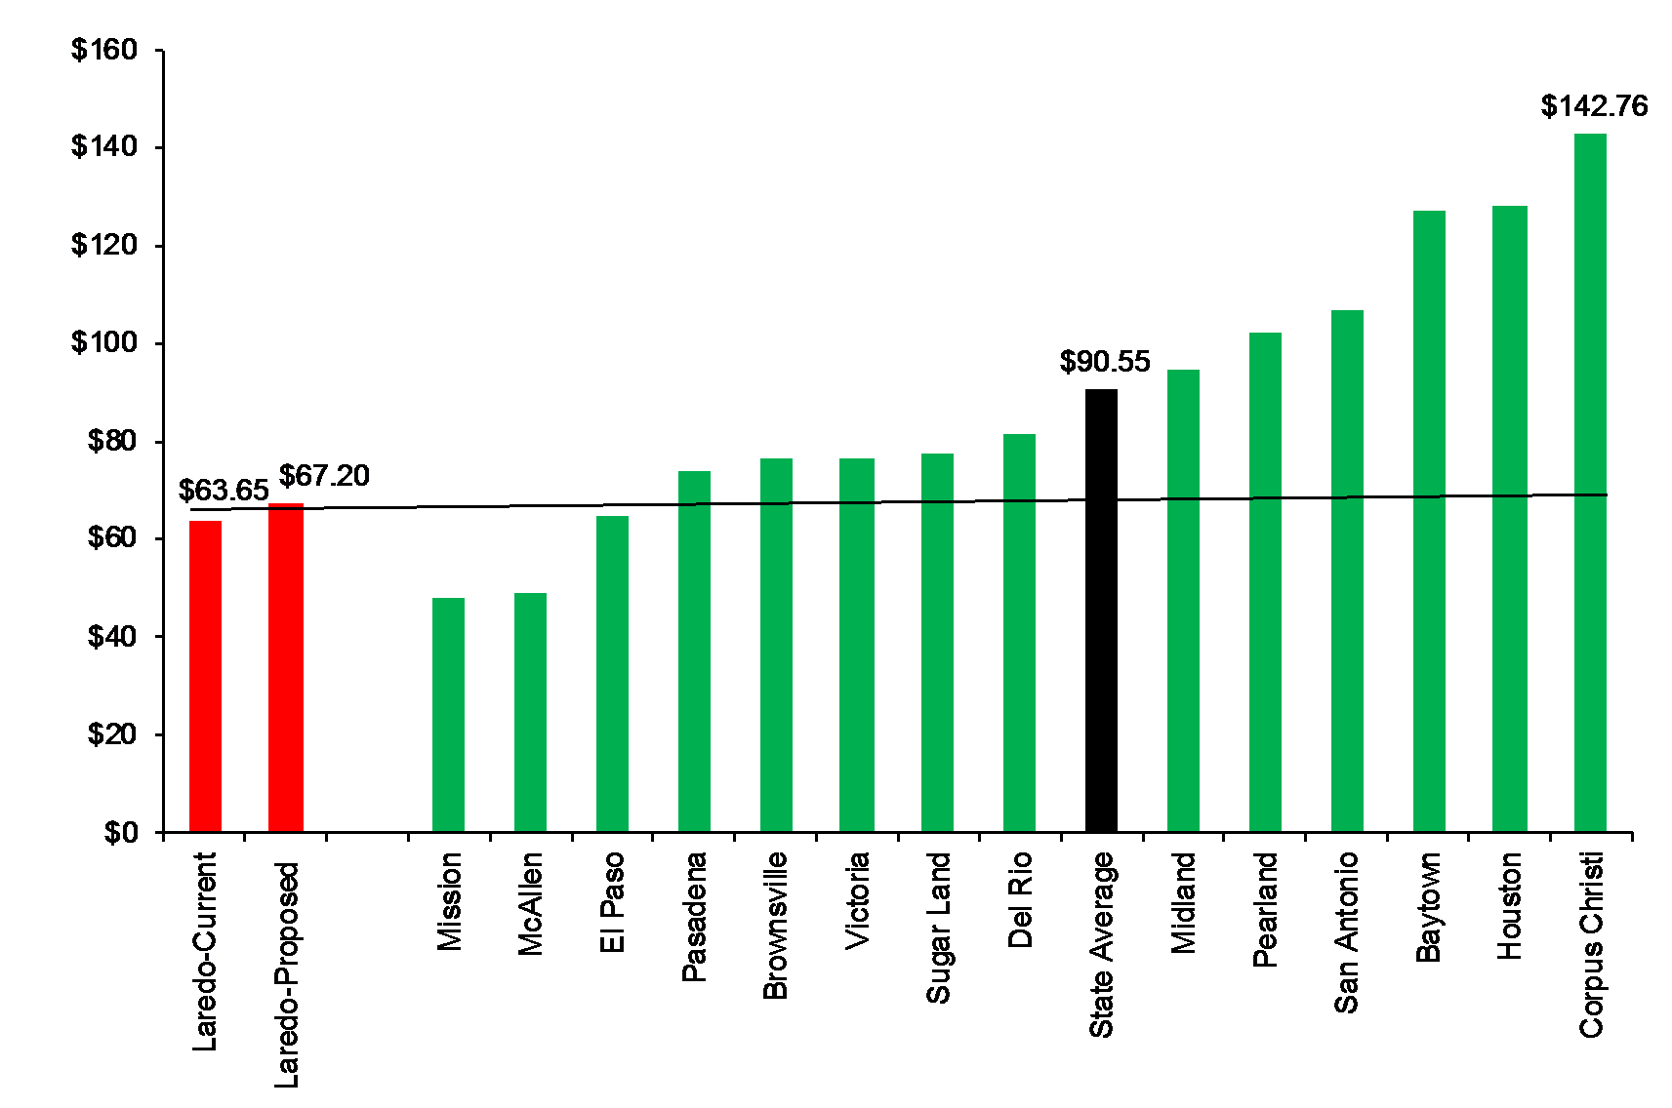
Monthly Residential Charge Comparison 10,000 Gal Water/Wastewater

Slide 23
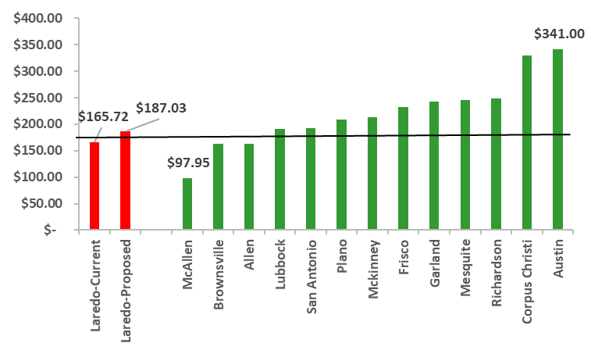
Monthly Commercial Charge Comparison 20,000 Gal Water/Wastewater

Slide 24
Effects on the Customers
Residential:
35% of customers will have a maximum increase of $2.00/month for use of 5,000 gallons or less water use.
40% of customers will have an increase of between $2.00-$3.55/month based on their water use between 5,000 to 10,000 gallons.
25% of customers will see a higher increase of more than $3.55 for use of 10,000 gallons or more.
Commercial:
73% of customer will have a maximum increase of $21.31/month for use of 20,000 gallons.
17% of customer will have an increase of between $21.31-$55.67/month for use of 20,000 to 50,000 gallons.
10% customer will see higher than $55.67/month increase based on their water consumption more than 50,000 gallons.

Slide 25
Presentation Summary
How Does Rate Plan Benefit City?
Will enable utility to operate on a stand-alone basis and independent of general fund assistance
Will result in financially-healthy utility that has ability to fund operations and capital needs
Will ensure that ratepayers are paying only what it costs to provide water and wastewater service
Will allow capital investment of $150-$180 million into system to improve quality of service and provide a well-functioning system for future generations

Slide 26
Questions?

